Slide 1

AXBOROT KAMUNIKATSION TEXNOLOGIYALARI VA ALOQA HARBIY INSTITUTI
Python dasturlash tili

Slide 2
Welcome to programming in Python

Slide 3
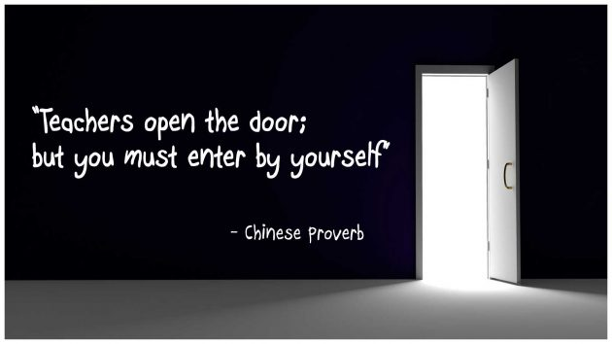

Slide 4
Python nima?
Python umumiy maqsadli dasturlash uchun interpretatsiya qilingan yuqori darajadagi dasturlash tilidir. Python dinamik turdagi tizim va avtomatik xotira boshqaruviga ega. U bir nechta dasturiy paradigmalarga, jumladan, ob'ektga asoslangan, majburiy, funktsional va protsedurani qo'llab-quvvatlaydi va keng va keng qamrovli standart kutubxonaga ega.

Slide 5
Java vs C++ vs Python
Java Program
public class Hello
{
public static void main(String argv[])
{
System.out.println(“Hello world!”);
}
}

Slide 6
Java vs C++ vs Python
C++ Program
#include<iostream>
int main()
{
std::cout << “Hello world” << std::endl;
return 0;
}

Slide 7
Java vs C++ vs Python
Python Program
print(“Hello world”)

Slide 8
Major uses of Python
System utilities
Web Development
Graphical User Interface GUI (Tkinter, gtk, Qt)
Internet Scripting
Distributed programming
Data Science

Slide 9
Data type
Python Numbers
Int x = 1, x = -8
Float y = 26.5, y = 12e8
Complex z = 1j, z = 3 + 7j

Slide 10
Data type
Boolean (bool)
x = True
type(x)
<class ‘bool’>
# False bilan ham shunday bir xil amal bajariladi

Slide 11
Data type
String – obyekt turi va ‘’ yoki “” bilan boshlanuvchi chars lar ketma ketligi String deb ataladi.
str_no = ‘Hello world’
print(str_no)
>> Hello world

Slide 12
Stringlar o’zgaruvchan emas
str_no = “Men talabaman”
str_no[0] = ‘S’
print(str_no)
Traceback (most recent call last): File "python", line 2, in <module> TypeError: 'str' object does not support item assignment

Slide 13
String built-in functions
strip() – bu metod boshidagi va ohuridagi whitespace ni olib tashlaydi
len() – string ni uzunligini aniqlaydi
lower() – kichkina harfga aylantiradi
upper() – katta harfga aylantiradi
replace() – string ni boshqa stringa aylantiradi
split() – string ni substring larga ajratadi

Slide 14
E’tiboringiz uchun rahmat

